Slide 1
Easy MDF Door Maker

Slide 2
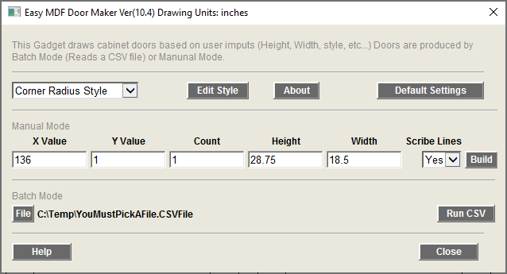
Main Screen
Drawing unites
Edit selected door Style
About gadget
Edit defaults setting
Select door style
Draw door (s) based on the setting shown here
Set the X value for draw door
CSF file to read
Run the batch mode process
Set the Y value for draw door
Set the number of doors drawn
Add scribe lines

Slide 3
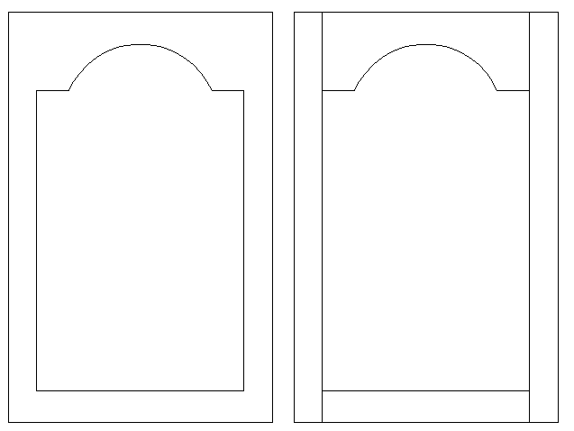
Scribe Lines
Without scribe lines
With scribe lines
Over cut amount

Slide 4
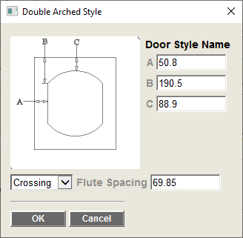
Style Edit Screen
Enter values for the items listed in the image

Slide 5
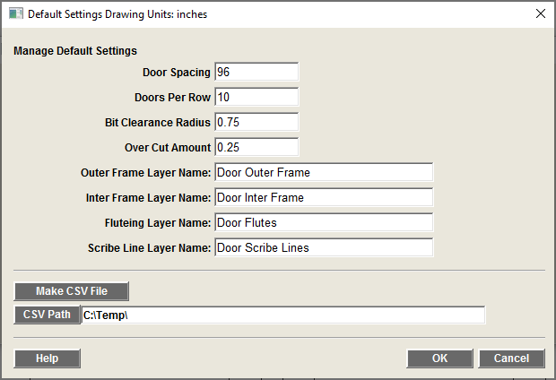
Defaults Screen
Distance between doors (see drawing)
Number of doors per Row in the drawing
Inter profile Bit clearance
Layer names
Project scribe line beyond door edge
Makes a seed CSV File (values are based on current drawing units)
Select where to make the seed CSV File

Slide 6
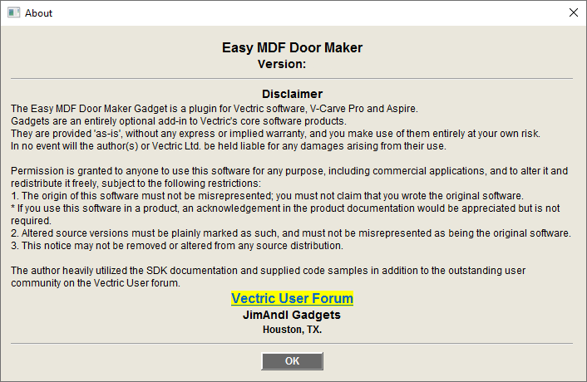
About Screen

Slide 7
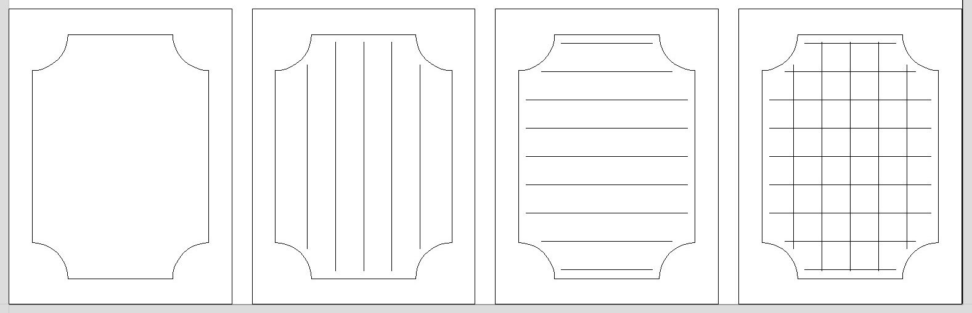
Fluting Options
Options:
None
Vertical
Horizontal
Crossing

Slide 8
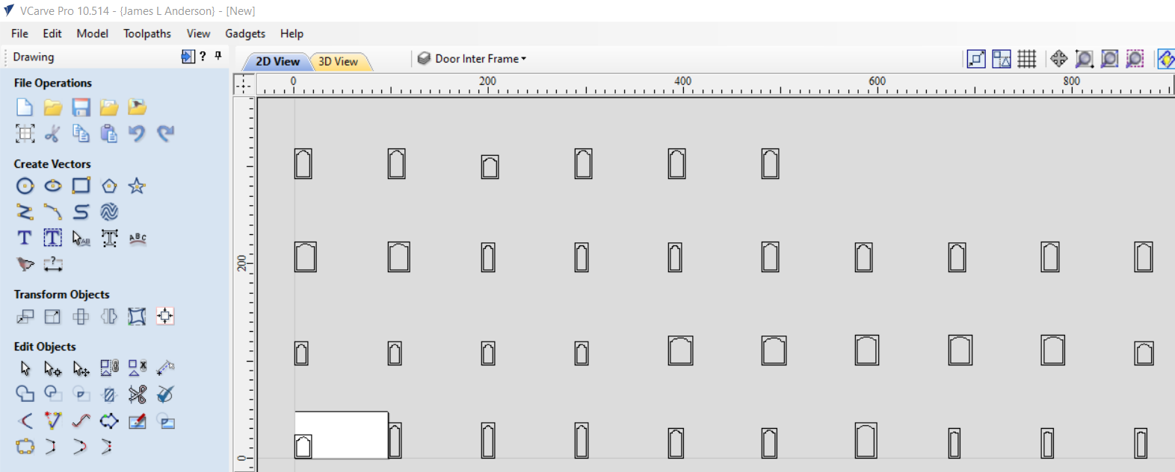
Drawing of Doors
Distance Between Door Value

Slide 9
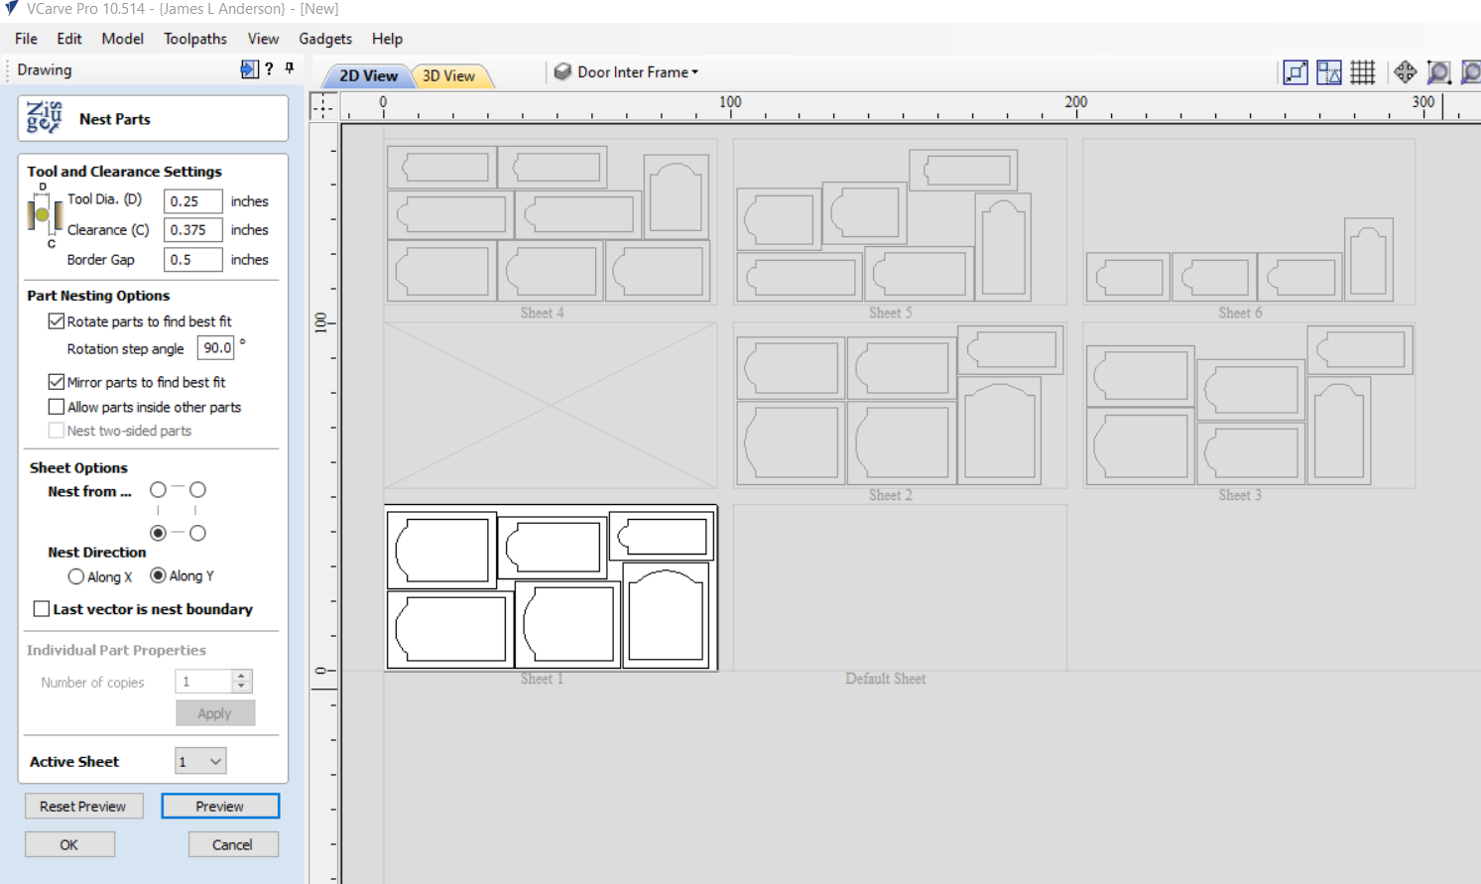
Using the Nesting Tool

Slide 10
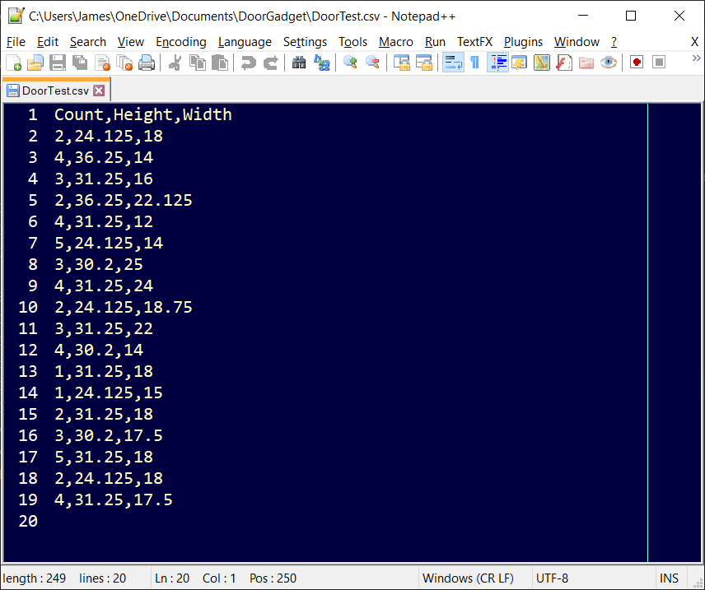
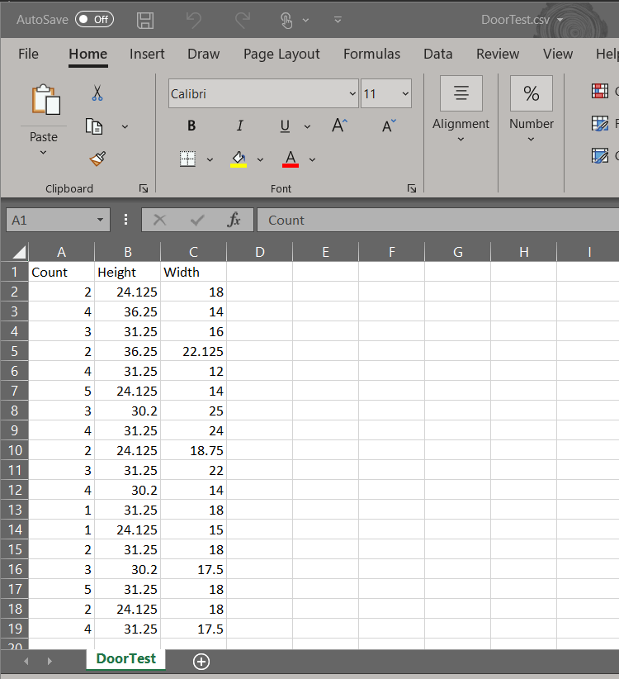
Edit CSV file in Excel or Text editor

Slide 11
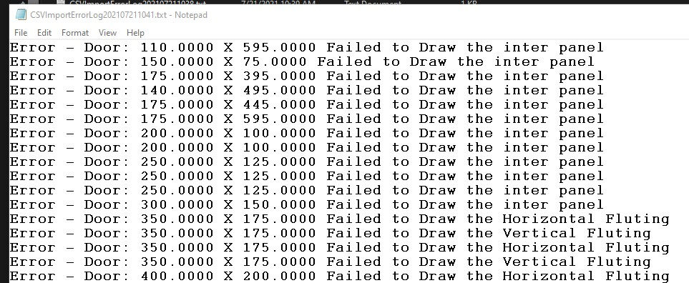
Error Log Report

